Slide 1
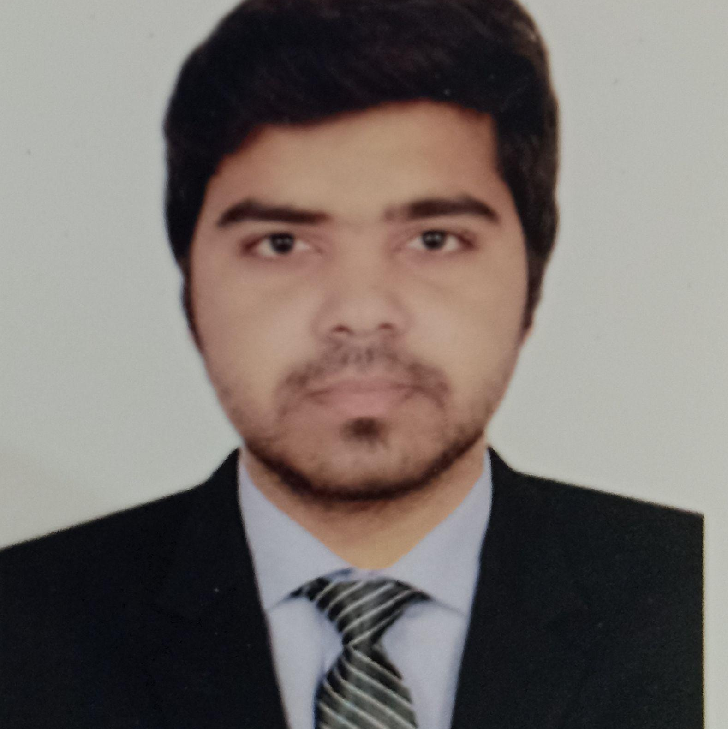



Naveen Pratap
Bachelor of Technology
Computer Science : 2018 - 2022
Skills
Java 8 /J2EE | Java Basics, OOPS, Generics, Collections, Arrays, Loops, Lambda Exp, Stream API Junit, Mockito, Servlets
Spring core | IOC & Dependency Injection, Autowire
Spring REST | REST controllers, Implementation of GET, POST, PUT & DELETE, Bean Validation & Exception Handling, Testing Services, Controller & Repository layer
Spring Data JPA | Implement DAO layer using spring Data repositories, Transaction Management
Spring Boot Microservices | Spring Boot Starters, annotations, Messaging Service, Sync/Async comms, Swagger API documents
Spring Cloud | Eureka, Netflix Ribbon, Feign Client, Netflix Hystrix, Netflix Zuul & Config Server
Angular | Components, Services, Modules, Routing, Forms & Validation, Testing using Jasmine & Karma
Database | MongoDB No Sql Basics My SQL RDS Basics
UI Tech | HTML 5 & CSS 3,JavaScript, ES6 & TypeScript Reusable templates, Optimized UI Designed
Tools | Git, Postman, Maven, IDE
Devops | CI/CD, Jenkins configuration, Build Pipelines, notifications, quality gate understanding
Add On skills | Communications, Team management. Peer learning
Mumbai
naveen.a.pratap@capgemini.com
+91 9720667601
Java Full Stack Development
Hands on experience in creating microservices with Springboot, Spring Security, Spring Cloud API Gateway, Eureka server, resilience 4J, load balancing and Rest Template
Proficient in creating Single page Web Application in Angular with Authentication with route guards, Angular reactive forms, angular routing, angular material and bootstrap
Hands on experience in implementing OAuth2
Experience in creating documentation with Java docs and swagger and in unit testing using Junit and Mockito
Development experience in creating docker images, creating images, pushing to docker hub including docker compose
In depth understanding of Git - Github, MongoDB and ES6
Online Hotel Management System
Completed end to end case study of Online Hotel Management System during training with microservice architecture with Spring Boot. Implemented JWT tokens, Swagger, API Gateway, Eureka Service Registry and load balancing.
Created the front end of the Online Hotel Management System using Angular, Angular Material, Angular Reactive form. Used MongoDb as NoSql database and Git and Github as version control.
Check out my work on GitHub & Video Profile

